Slide 1
Enhancement of Bluetooth Security by Improving RSA Algorithm
Submitted by
Md. Akibul Alam (0804060)
Supervised By
Thomas Chowdhury
Assistant Professor, Dept. of CSE, CUET

Slide 2



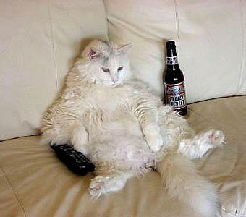


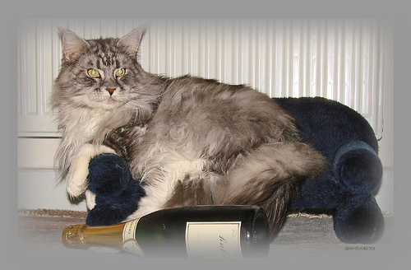
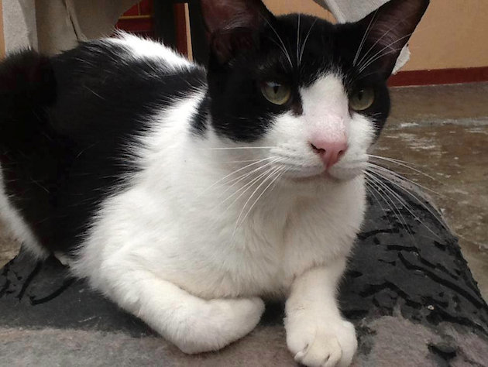
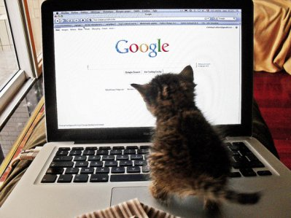
Motivation
Owner
Owner
Security by improved RSA algm (Proposed System).
Several Cryptanalyst
How can I protect it ?
owner
Secure Data
Data Hacking
Data in Network
Data
Yes it is protected ☺

Slide 3


Objectives
1. Propose an improvement of Bluetooth security through RSA algorithm.
RSA
Algorithm
2. Provide a secure way to connect and exchange data between devices through Bluetooth.
Improved
RSA
Improvements

Slide 4
Limitation of Bluetooth Security
RSA algorithm
Winners attack
Man-in-the-Middle Attack
Surveillance Attacks
DoS Attacks
Malware Attacks
Obfuscation Attacks
Sniffing Attacks
UDDA Attacks
Fuzzer Attacks
Bluetooth
Mathematical attack
Limitations
Faulty key generation
Integer factorization problem
Side-channel / timing attacks
Adaptive chosen cipher text attacks

Slide 5
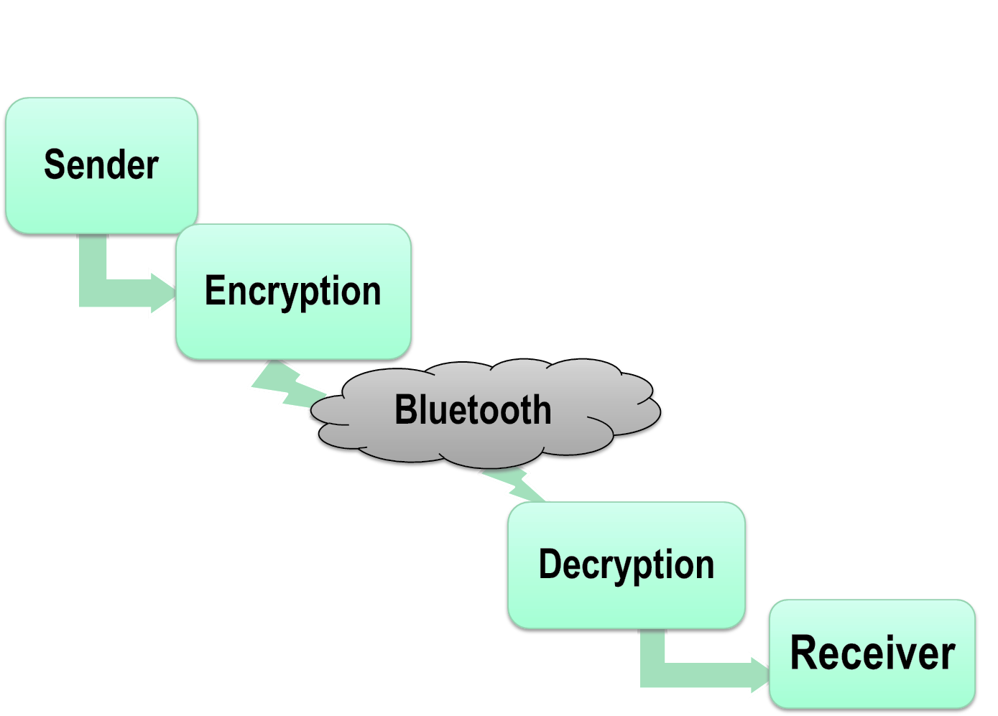

Methodology
Methodology
Improved RSA
Figure 1: Improvements of Bluetooth data transfer process
Figure 1: Existing Bluetooth data transfer process

Slide 6
RSA Algorithms Extension (Proposed)
Cipher text 2
Original Message
RSA
Improvements
Sender key K-PUB
Cipher text 1
Cipher text1
Receiver key K-PRIV
RSA
Cipher text 2
Original Message
Figure 3: Decryption Improvements
Figure 2: Encryption Improvements

Slide 7
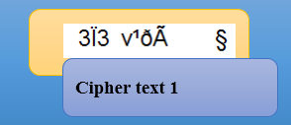
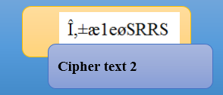

Implementations
RSA Bluetooth
Send to Bluetooth
Encrypted by RSA
Encrypted by sender key (K-PUB)
Plain text (original messages)
Figure 10: Encryption Process

Slide 8
Implementations (Cont.…)
RSA Bluetooth
Plain text
(Original messages)
Decrypted by Receiver key (K-private)
Decrypted by RSA
Received Cipher text
Figure 11: Decryption Process

Slide 9

Complexity
RSA
Vs
Result!!
Proposed Algm.
Time complexity is higher than RSA.
So why proposed algm.?
Algorithm Analysis
Figure 9: Encryption Time Vs data size.

Slide 10
Complexity (Cont.…)
Existing latest Bluetooth security Vs Proposed Security system
Though time complexity is higher than RSA, but comparing with latest Bluetooth security system, propose system is secure & faster.
Bluetooth System Analysis

Slide 11



Challenges
Cipher text with improved RSA
Apply Successful Attack
Results : Another Cipher text found
Cipher text, timing & key Attacker

Slide 12


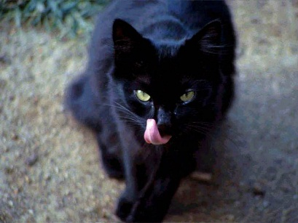
Attacks Removing
Winners Attack
Attackers decide that, attack was not successful
From Successful Winners Attack. p=79 , q=53. RSA is decrypted
Final Results: Another cipher text found
Cipher text using proposed system
Figure 14: Winner attack

Slide 13
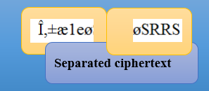

Attacks Removing (Cont.…)
Timing attacks
So attackers decide that, attack was not successful
Attacks on multiplication
Cipher text using proposed system
A successful approach to timing attack (Cipher text separation)
Final Results of timing attack
Figure 15: Timing attack

Slide 14

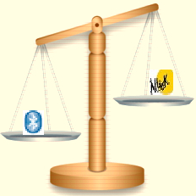
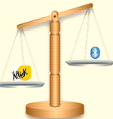
Comparison of Bluetooth Securities
Proposed System
4.Triple DES,RSA, MD5 has high time complexity. Exceed the memory & space complexity.
3. DES & RSA has Brute force attack, high time complexity & No any process proposed for verifying the integrity of message.
Current 128 bit E₀ has low credibility of PIN, Address spoofing & same keys are use for different parties.
2. DES has key distribution problem & more vulnerable to attacks because of small key size.
1. Higher speed & security for Bluetooth data transfer.
2. Latest attacks like winners, timing etc. solved.
3. Gives a new era of safeness for vehicular technology.
Latest
Existing

Slide 15
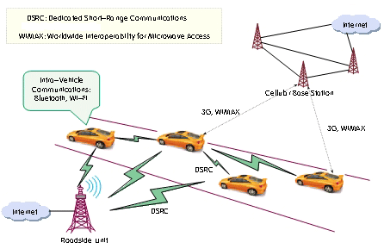

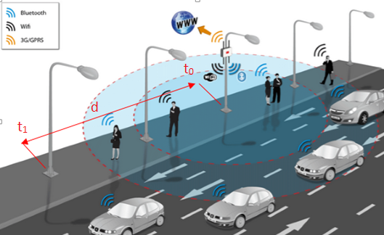

Applications
Voice for our next generation
Gift a crime free & safe world for the next
☺ ☺ ☺
Vehicular Communication infrastructure (VCI)
Speed calculation: $v=\frac{d}{\text{t}\text{1}−\text{t}\text{0}}$ m/s
NQR
NQR
1. Carrying atomic or any bomb in road
2. Traffic signal control through lamppost.
3. Drugs detection

Slide 16
References
[1] Wuling Ren, Zhiqian Miao, “A Hybrid Encryption Algorithm Based on DES and RSA in Bluetooth Communication” In Proceedings of the Second International Conference on Modeling, Simulation and Visualization Methods. Sanya, pp. 221-225, May 2010.
[7] Trishna Panse, Vivek Kapoor“An Integrated Scheme based on Triple DES, RSA and MD5 to Enhance the Security in Bluetooth Communication”, International Journal of computer Application, July 2012. (0975-8887) volume 50- No.7.
[2] Li Juan, Chen Bin, Li Kun “Study on the Improvement of Encryption Algorithm of Bluetooth” In Proceedings of the 2009 International Conference on Networking and Digital Society (ICNDS '09 ). ACM, Volume 01, pp. 88-92, May 2009.
[8] Nagadeepa N. “Enhanced Bluetooth Technology to Assist the High way Vehicle Drives”, Research Journal of Recent Sciences, August 2012. Vol. 1(8), pp.82-85.
[9] P. C. Kocher. “Timing Attacks on Implementations of DiffieHellman, RSA, DSS and Other Systems” Volume 1109 of LNCS pp. 104-113.
[3] Trishna Panse, Vivek Kapoor, Prashant Panse, “A Review on Key Agreement Protocols used in Bluetooth Standard and Security Vulnerabilities in Bluetooth Transmission” International Journal of Information and Communication Technology Research, March 2012 Volume 2, Issue 3, pp. 315-318.
[4] Sun J, Howie D, Koivisto A & Sauvola J “Design, implementation, and evaluation of Bluetooth security”. In Proceedings of the IEEE International Conference on Wireless LANs and Home Networks, Singapore, 2001, pp. 121 - 130.
[5] Trishna Panse, Vivek Kapoor,“A Review on Security Mechanism of Bluetooth Communication”, International Journal of Computer Science and Information Technologies, 2012, Vol. 3 (2) , pp. 3419-3422.
[6] Dhem, Koeune, Leroux, Mestre, Quisquater, and Willems. “A Practical Implementation of the Timing Attack” In Proceedings of the third International Conference, CARDIS’98, Louvain-la-Neuve, Belgium, September, 1998 volume 1820 pp. 167-182.

Slide 17
Thanks to all
Be Safe

